Slide 1
Welcome to CS10 Group Seventh Meeting
Team member
Wilma Liu (Leader)
Fiona Hu
Pat Zhang
Elvia Tong
Reehaa Ding
William Quan

Slide 2
This week meeting schedule
Report progress and ask for feedbacks
Traveling Problem impact Forecasting
Basic theory about the forecast model implemented
Improved forecast model
Business Close Support Success Measurement
Lists of the supports measured
Improved support success measurement visualizations/ dashboards

Slide 3
Review - Travelling problem
The reason why investigate tourism problem
1) a significant contributor to the Australian economy
2) The main seasonal income for unskilled labour, especially for lower income groups
Demonstrate the change of international arrivals of short-term visitors by using visualisation

Slide 4
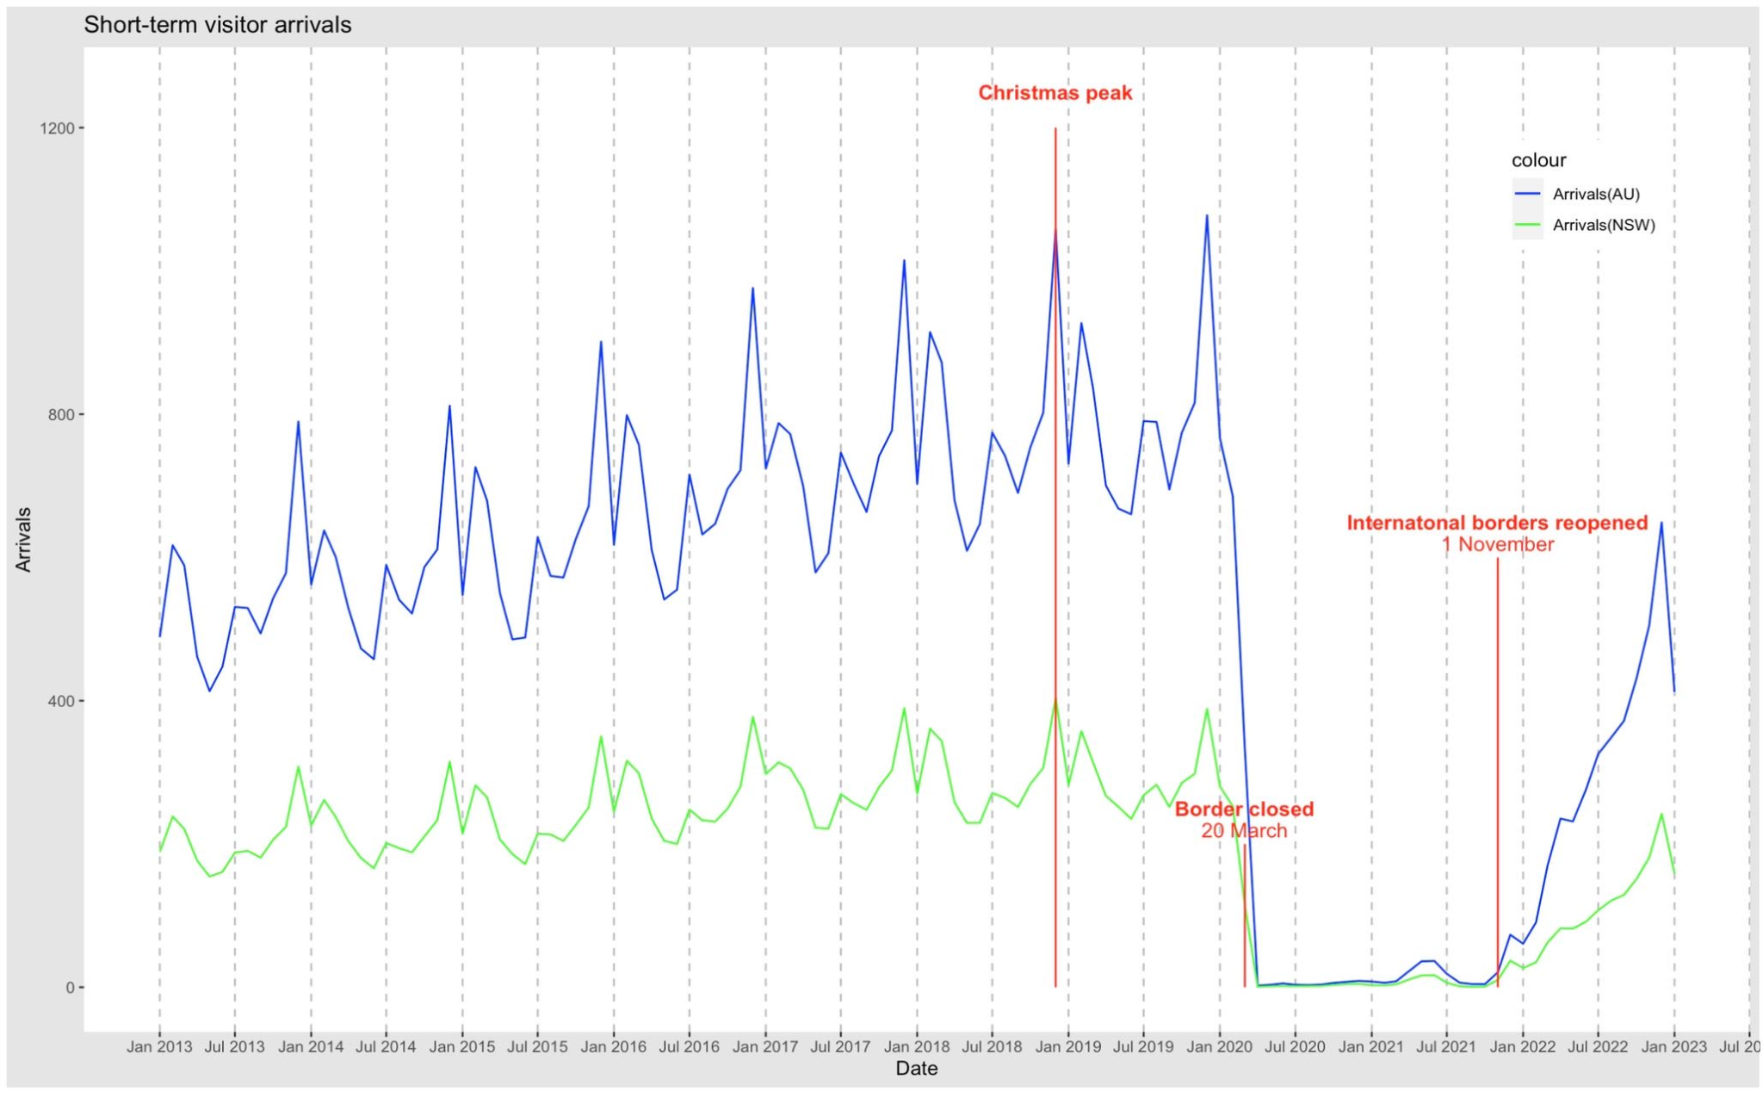
Review - The change of the number of arrivals

Slide 5
What will we discuss today?
Basic theory of LSTM model
Implementing LSTM model to predict estimated recovery time period that reach the pre-crisis level.
Improved forecast model

Slide 6
Travelling problem impact forecast- Model
The number of arrivals
1) Monthly data
2) From SARS to Covid-19
Two machine learning ways for time series data
1)LSTM model
2)Transformer model

Slide 7
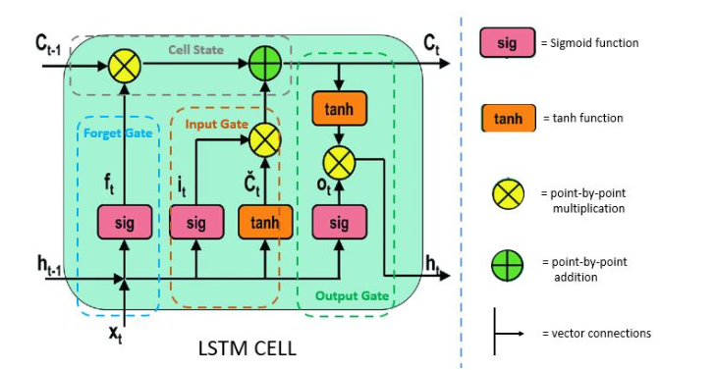
Travelling problem impact forecast- LSTM model
Long Short Term Memory
a type of recurrent neural network (RNN) architecture
capture long-term dependencies in the input monthly travelling number
three main components
1)input gate: add new information
to the cell state
2)forget gate: discard information
based on the current and past
3)output gate: output the current cell state

Slide 8
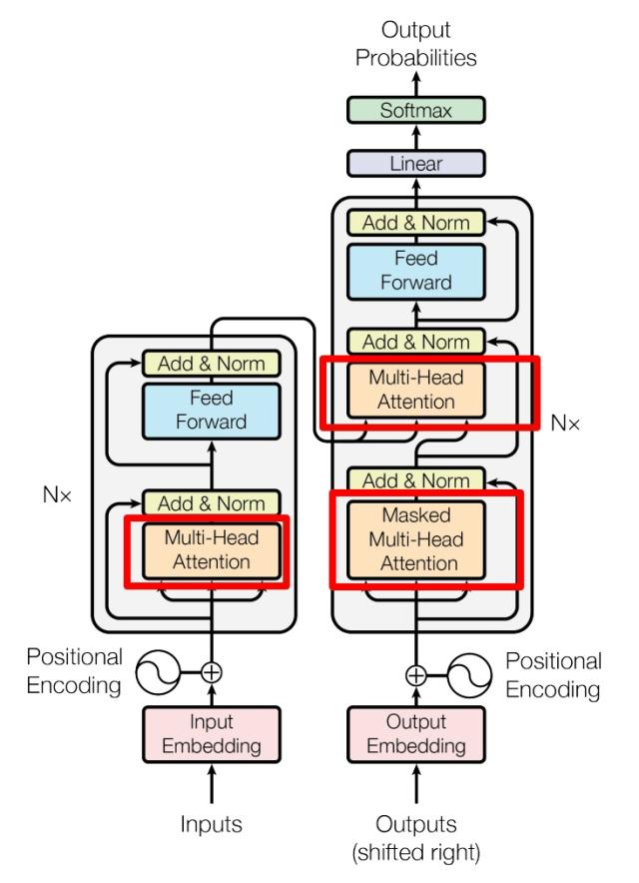
Travelling problem impact forecast- Transformer
Transformer Model
a type of neural network architecture
for seq2seq with the Encoder-Decoder
structure
a self-attention mechanism to compute
the importance of different positions,
containing three main parts
1)Query vector: specify what information to look for in the input sequence
2)Key vector: represent the features of each position
3)Value vector: represent the value of each position
We calculate the similarity between the query vector and the key vector to weight the value vectors to obtain the final output.

Slide 9
Improved forecast model demonstration

Slide 10
Travelling problem impact forecast- Feedback
Any improvements or suggestions on travelling problem impact forecast

Slide 11
Business Close Support Success Measurement
Interactive Dashboard Visualizations (BA,DA)
Identifying Trends of the success of supporting business with different Business sizes and Turnover (Narrow Down)
Business Counts Operating in 2018, Survival in 2019-2022 by different industries
Business Counts Entry in 2018, Survival in 2019-2022 by different industries
Business Counts Survival in 2020-2022 by different industries and regions
Python Automated Visualization (DS)
Automated Visualization generation- Flexibility and Reproducibility

Slide 12
Business Close Support Success Measurement- Past Government Support For The Business
Support Name | Date | Business Size | Turnover
$10,000 small business support grant (2020) | June 2020 | 0-20 | Less than 75k
$3,000 small business recovery grant (2020) | July 2020 | 0-20 | Less than 75k
Micro-business grant | July 2021 | 0-20 | Less than 75k
JobSaver payment | July 2021 | 20+ | Over 75k
Business grant | July 2021 | 20+ | Over 75k
Small business support grant | Feb 2022 | 0-20 | Less than 75k

Slide 13
Business Close Support Success Measurement- Big business grant
Support Name | Date | Business Size | Turnover | Available Fund
JobSaver payment | July 2021 Oct 2021 Oct 2021 | 20+ | 75k-250m | 1.5k-100k per week 1.12k-75k per week 0.56k-3.75k per week
Business grant | July 2021 | 20+ | 75k-50m | Tier 1: 7.5k Tier 2:10.5k Tier 3: 15k

Slide 14
Business Close Support Success Measurement- Small business grant
Support Name | Date | Business Size | Turnover | Available Fund
$10,000 small business support grant (2020) | June 2020 | 0-20 | Less than 50k | 10k
$3,000 small business recovery grant (2020) | July 2020 | 0-20 | Less than 50k | 3k
COVID-19 micro-business grant (2021) | July 2021 | 0-20 | Less than 50k | 1.5k per fortnight 0.75k per fortnight (after 30 Oct)
Small business support grant (2022) | Feb 2022 | 0-20 | Less than 50k | 0.75k-2k per week 0.5 k per week (non-employing)

Slide 15
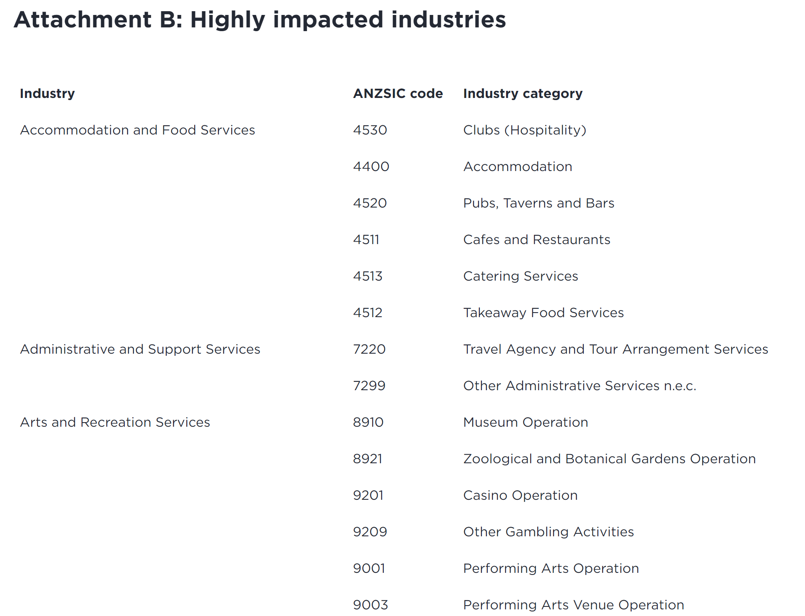
Business Close Support Success Measurement- Past Government Support For The Business

Slide 16
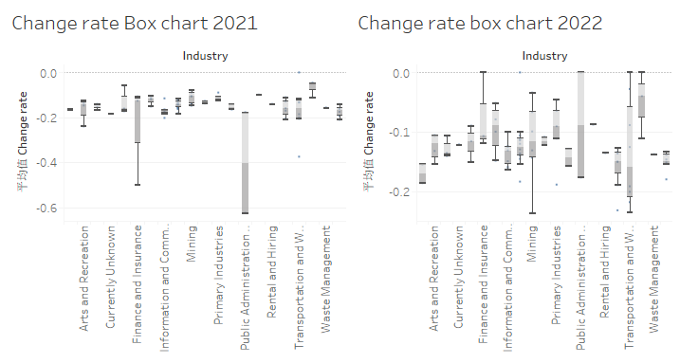
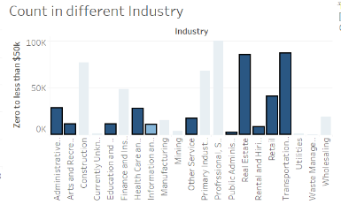
Business close support success measurement- Last week visualization

Slide 17
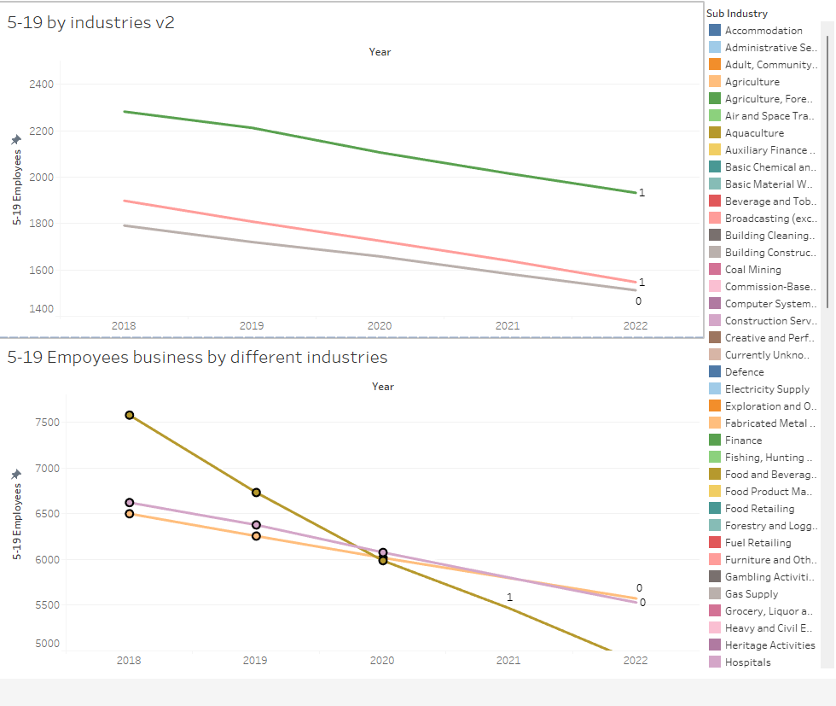
Business close support success measurement- Last week visualization

Slide 18
Business close support success measurement- This week
Measure the success of the support to the small businesses-in 2020,2021 by specific industries
Success Measurement Criteria: Business close rate deceleration
Conclusion: The small business grants is successful/ unsuccessful to specific industries’ small businesses in 2020,2021.

Slide 19
Business Close Support Success Measurement- Small business grant
Support Name | Date | Success Measurement Criteria
$10,000 small business support grant (2020) | June 2020 | Business close rate deceleration by industry in 2021
$3,000 small business recovery grant (2020) | July 2020 | Business close rate deceleration by industry in 2021
COVID-19 micro-business grant (2021) | July 2021 | Business close rate deceleration by industry in 2022
Small business support grant (2022) | Feb 2022 | Business close rate deceleration by industry in 2022

Slide 20
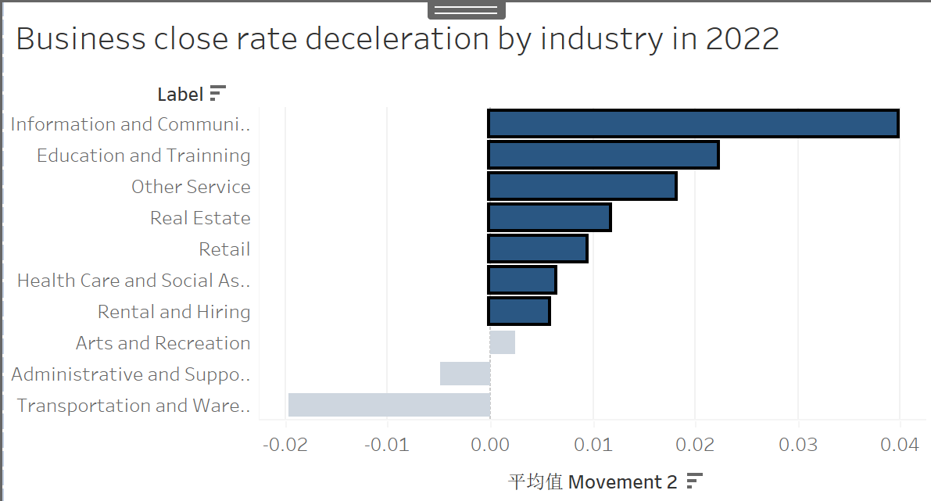
Business close support success measurement- This week
Measure the success of the support to the small businesses-in 2020,2021 by specific industries
Success Measurement Criteria: Business close rate deceleration
Conclusion: The small business grants is successful/ unsuccessful to specific industries’ small businesses in 2020,2021.
Recommendation:

Slide 21
Business Close Support Success Measurement- Small business grant
Support Name | Date | Business Size | Turnover | Available Fund
$10,000 small business support grant (2020) | June 2020 | 0-20 | Less than 50k | 10k
$3,000 small business recovery grant (2020) | July 2020 | 0-20 | Less than 50k | 3k
COVID-19 micro-business grant (2021) | July 2021 | 0-20 | Less than 50k | 1.5k per fortnight 0.75k per fortnight (after 30 Oct)
Small business support grant (2022) | Feb 2022 | 0-20 | Less than 50k | 0.75k-2k per week 0.5 k per week (non-employing)

Slide 22
Business close support success measurement- This week
Measure the success of the support to the small businesses-in 2020,2021 by specific industries
Success Measurement Criteria: Business close rate deceleration
Conclusion: The small business grants is successful/ unsuccessful to specific industries’ small businesses in 2020,2021.
Recommendation:
COVID-19 micro-business grant (2021)
Small business support grant (2022)

Slide 23

Business close support success measurement- This week
Measure the success of the support to the small businesses-in 2020,2021 by specific industries
Success Measurement Criteria: Business close rate deceleration
Conclusion: The small business grants is successful/ unsuccessful to specific industries’ small businesses in 2020,2021.
Recommendation:
COVID-19 micro-business grant (2021)
Small business support grant (2022)

Slide 24
Business close support success measurement- Python Automated Visualization

Slide 25
Business close support success measurement
This week
Next week
Measure the success of the support to the small businesses-in 2020,2021 by specific industries
Success Measurement Criteria: Business close rate deceleration
Conclusion: The small business grants is successful/ unsuccessful to specific industries’ small businesses in 2020,2021.
Measure the success of the support to the small businesses-in 2020,2021 by specific sub industries
Success Measurement Criteria: Business close rate deceleration
Conclusion: The small business grants is successful/ unsuccessful to specific sub industries small businesses in 2020,2021.
Following week:
Success measurement by both industries and regions
Success measurement by different num of employees
Success measurement of New Entries businesses

Slide 26
Thank you !!!

